Slide 1

Recordkeeping and Reporting
Technical Services Division, MIOSHA

Slide 2
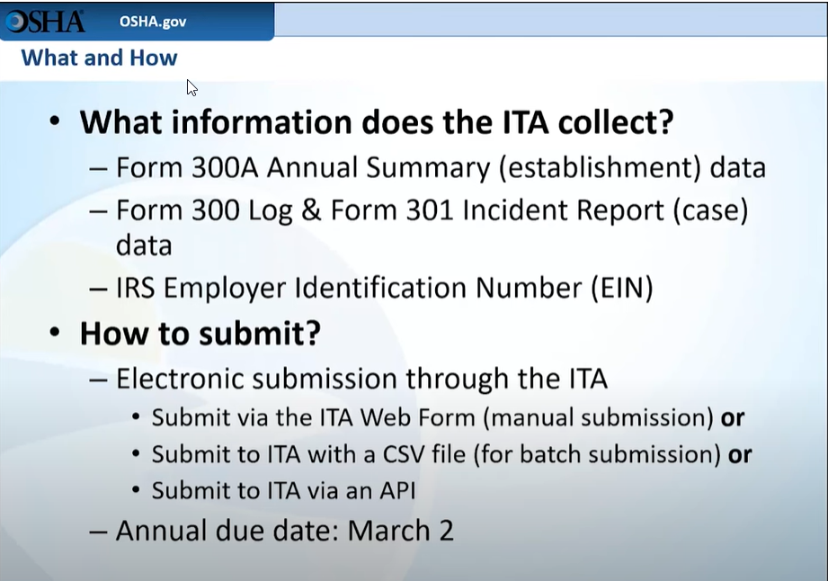
What and How to Submit Data
Notes:
OSHA’s electronic reporting requirements are based on the industry classification of the establishment not the industry classification of the firm.
OSHA defines an establishment as a single location of where services or industrial operations are performed.
It is a requirement to submit your data for each establishment.
The respondent can submit the data through the web form if there are a few establishments.
If there are multiple establishments, it is recommended to submit data with a CSV file or if there are many cases from one or more establishments. This will save the employer time.
An API is an Application Programming Interface.

Slide 3

Administrative Rule Part 11
ELECTRONIC SUBMISSION OF INJURY AND ILLNESS RECORDS TO OSHA R 408.22141 Basic requirement.
Employers will need to know:
NAICS Code
Number of Employees
The injuries on their log
Notes:
You may be asked where the rule says that they must report their data to OSHA. The reference is found in Part 11, Recording and Reporting of Occupational Injuries and Illnesses. It is found in Rule 408.22141. The employer will need to know their NAICS code and their employee count to determine if they need to report or not. They will also need their injury logs available.

Slide 4
Appendix A-C
Appendix A- Partially exempt
Appendix B- Form 300 A 20-249 employees
Appendix C- 300 log and 301 report 100 or more employees
Notes:
Appendix A- Employers are not required to keep MIOSHA injury and illness records unless they are asked, in writing by OSHA or the Bureau of Labor statistics, or a state agency operating under the authority of OSHA or the BLS. They are still expected to report any employee’s fatality, in-patient hospitalization, amputation, or loss of eye.
Appendix B- Mandatory Annual Electronic Submission of MIOSHA Form 300A “Summary of work-related illnesses by establishments with 20-249 employees in Designated Industries.
Appendix C- Annual Electronic Submission of MIOSHA Form 300 Log of work-Related injuries and illnesses and OSHA Form 301 injury and illnesses incident report by Establishments with 100 or More employees in designated industries.

Slide 5
Reporting 300A Only
Establishments with 20 or more employees that are in appendix B, but not in appendix C must annually submit the 300A.
Establishments with 250 or more employees and you are required to keep records but are not in appendix C must annually submit the 300A.
Notes:
Employers sometimes need guidance to determine if they need to report their 300A annual summary.

Slide 6

Reporting 300, 300A, 301
Establishments that have 100 or more employees at any time during the previous calendar year that are classified in an industry in Appendix C must submit forms 300, 300A and 301 logs. Must report fatalities & severe injuries. Also, under rule 408.22142 must comply with data request from BLS.
Notes:
It is important to note that the establishments that have over 100 employees that are in Appendix C must annually file their 300,300A and 301 logs.

Slide 7
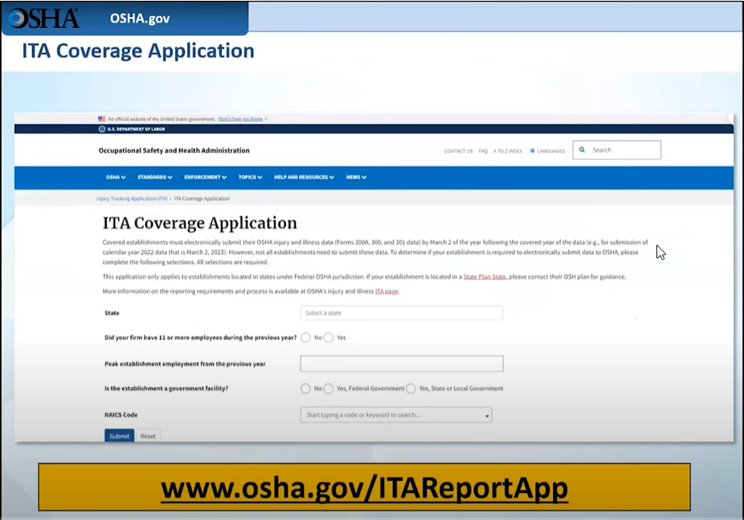
ITA Coverage Application
Notes:
This application will help respondents determine if they need to submit their Injury and Illness data to OSHA.
The respondent would answer the 4 questions on the slide.
The first question is what state are you in?
The second question is do you have 11 or more employees during the previous year?
The third question is what was your peak employment from the previous year?
The fourth question is the establishment a government facility?
The final field is asking for the NAICS code field. The application will allow the respondent to start to enter the NAICS code or start to enter the description of what their business does and will allow the employer to select the code from the list.

Slide 8
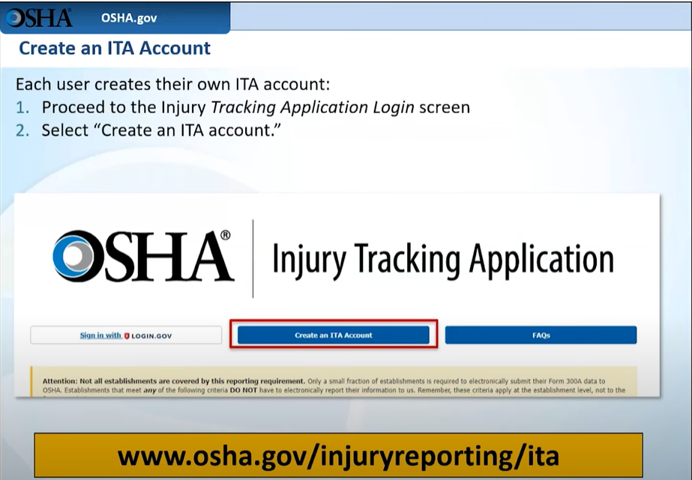
Create ITA Account
Notes:
It is important to note that OSHA will only accept information that is submitted through the ITA(Injury Tacking Application) website.
The data cannot be mailed or emailed to OSHA.
A link for the high hazard industry list is provided on this slide.

Slide 9
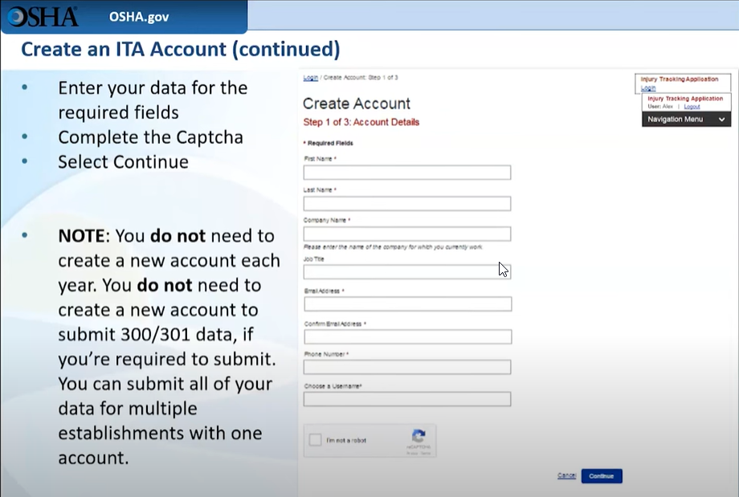
Create ITA Account (cont.)

Slide 10
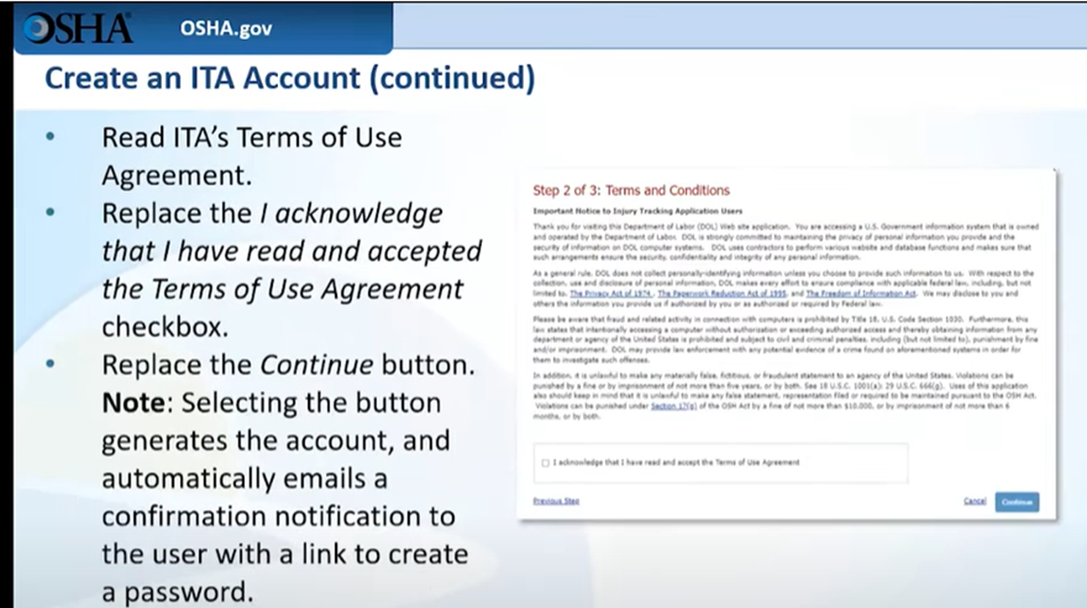
Create ITA Account (cont.)
Notes:
The respondent will need to read the terms of agreement. They will need to click the box and that will generate the account, and automatically emails a confirmation Notification to the user with a link to create a password

Slide 11
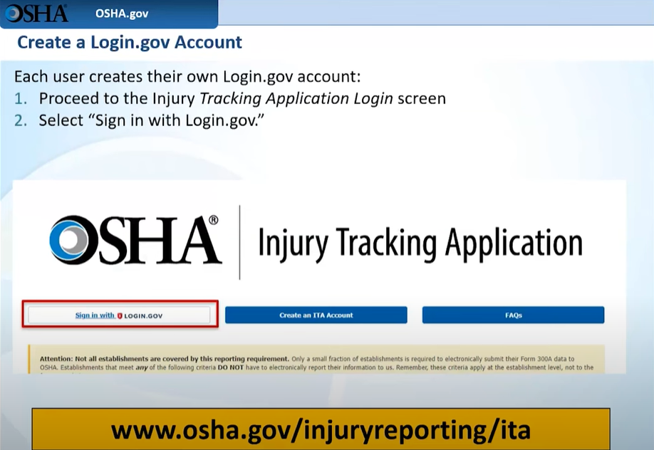
Create a Login.gov Account
Notes:
Next the user will need to create their own login.gov account.
Step 1 is to proceed to the injury Tracking Application login screen and select the sign in with login .gov tile.

Slide 12
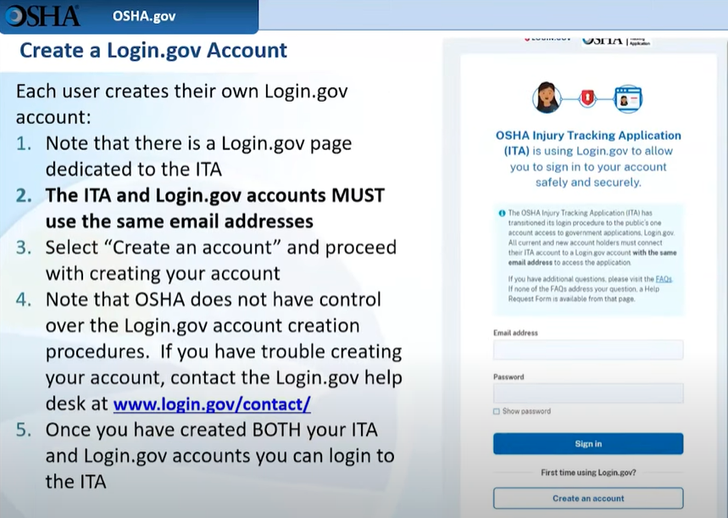
Create a Login.gov Account (cont.)
Notes:
Each user creates their own login/gov account.
There is a login .gov page that is for the ITA.
It is important to note that the ITA and Login,gov MUST use the same email addresses.
OSHA does not have control over the Login.gov account creation procedures. If the employer is having trouble creating their account they must contact the LOGIN,gov help desk at www.login.gov/contact/
Once both the ITA and Login.Gov accounts are created you can log into the ITA.

Slide 13

Reporting Due Date
R 408.22141b Reporting dates. Rule 1141b. Establishments that are required to submit under R 408.22141 will have to submit all the required information by March 2 of the year after the calendar year covered by the form or forms.
Notes:
The rule that spells out when the due date is above. The date that the data needs to be submitted by is March 2nd. The employers can start submitting as early as January 2nd.

Slide 14
Helpful Links for Reporting to ITA
First time using the ITA, or looking for help?
https://www.osha.gov/injuryreporting
Have a question about the requirements or using the ITA?
https://www.osha.gov/injuryreporting/faqs
Questions about OSHA Injury and Illness Recordkeeping?
ADMN Part 11, Recording and Reporting of Occupational Injuries and Illnesses
Need assistance with a help request?
https://www.osha.gov/injuryreporting/ita/help-request-form
Notes:
There are several helpful links in the Injury tracking Application Page.
First Time reporting to ITA – How to tutorials, OSHA Requirements, and ITA Account Information.
FAQ Page – Helpful links for many frequently asked Questions. Click on the links to see the information.
OSHA Injury and Illness Recordkeeping – Pages 21 and 22 the Electronic Submission of Injury and Illness Records to OSHA
Need Assistance – the help request form link will help you submit a request for assistance

Slide 15

Reference Page
ADMN Part 11, Recording and Reporting of Occupational Injuries and Illnesses
Using OSHA’s Injury Tracking Application to Submit Your Form 300A and Form 300/301 Data – Webinar: https://youtu.be/kAOe7bHs9x4
Notes:
For your convivence there are web addresses on this Reference Page for additional information.

